Slide 1
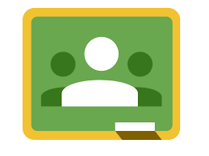
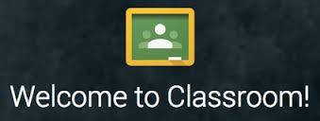
Google Classroom

Slide 2

What is Google Classroom?
Google Classroom is available to schools with a Google
Apps for Education (GAfE)domain.
Classroom is a way to get all of
your students in one place and
allows you to easily assign work
and for students to turn it in.
Home base for google drive.

Slide 3
Helps teachers create and collect assignments paperlessly
Includes time-saving features (i.e. make a copy of a Google Document for each student).
Creates Drive folders for each assignment & student
Students can keep track of what’s due on the Assignments page and begin working with just a click.
Teachers can quickly see who has or hasn't completed the work, and provide direct, real-time feedback and marks from within Classroom.

Slide 4
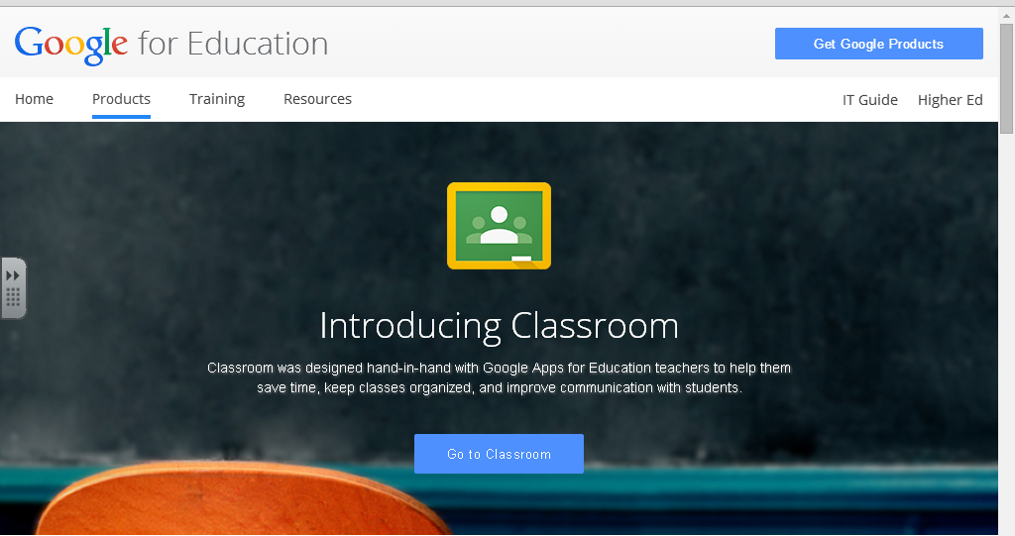
How to Create Your Own Class
Click to go to Google classroom! Click go to classroom.

Slide 5
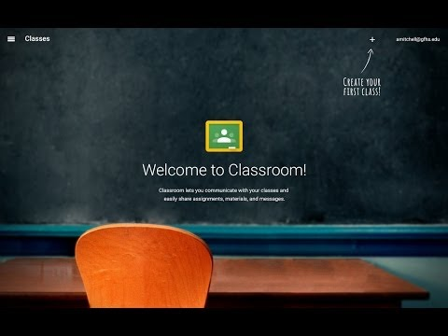

Slide 6
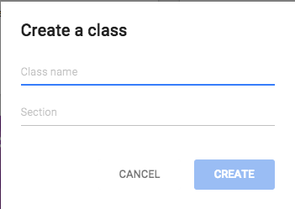
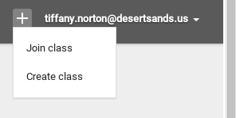
How to Create Your Own Class
Click on the Plus sign by your name and click create class. Type in your class name and section. Then click create.

Slide 7
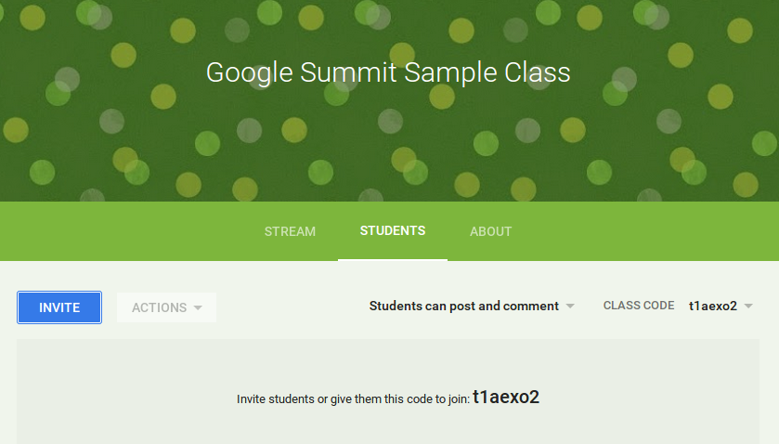
Two Ways to Have Students Join
Students can go to google classroom and type in the code for your classroom.
Invite students via e-mail to join your class. They’ll get a link to click on.

Slide 8
Using the Classroom Code to join:
Go to Google Classroom.
Click on the plus sign in the right hand corner.
Click join class.
Then type in the
classroom code
and click join.

Slide 9
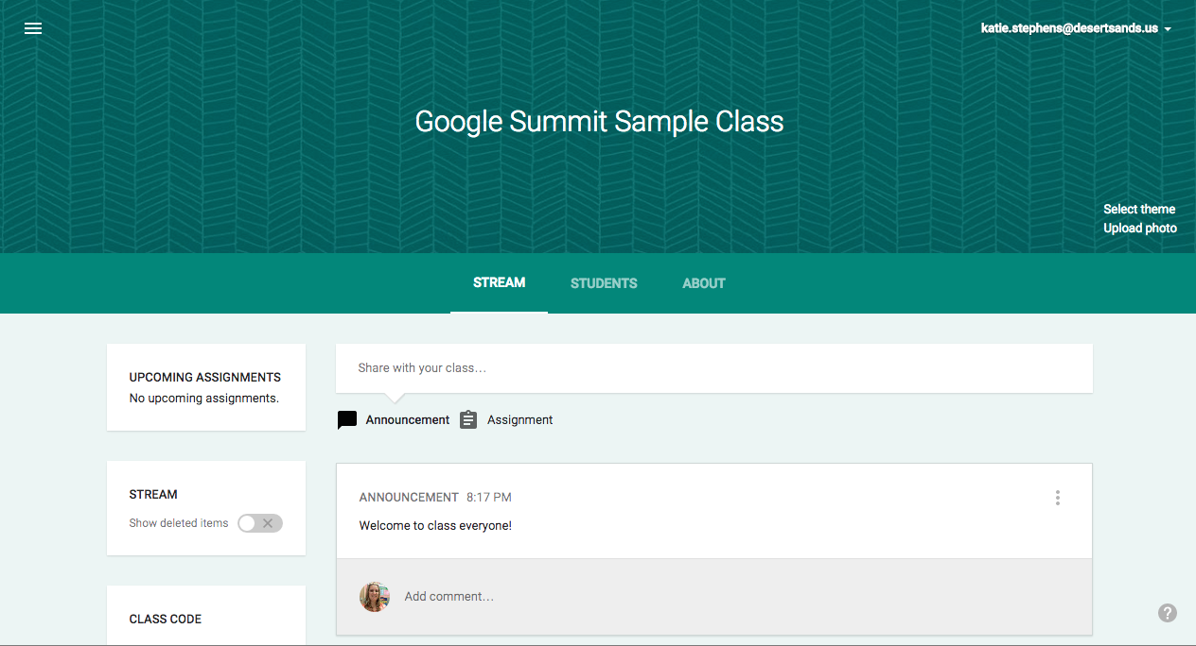
Classroom Homepage

Slide 10
Parts of your Classroom
Where your announcements and assignments are posted.
Change your classroom theme or add your own photo at the top of your Google Classroom.

Slide 11
Parts of your Classroom
Lists the names of assignments and when they are due.
Option that you can turn on or off to show your deleted items. Only teachers can use this feature.
Code that you give your students to join the classroom. You can also change the class code whenever you want to as the teacher.

Slide 12
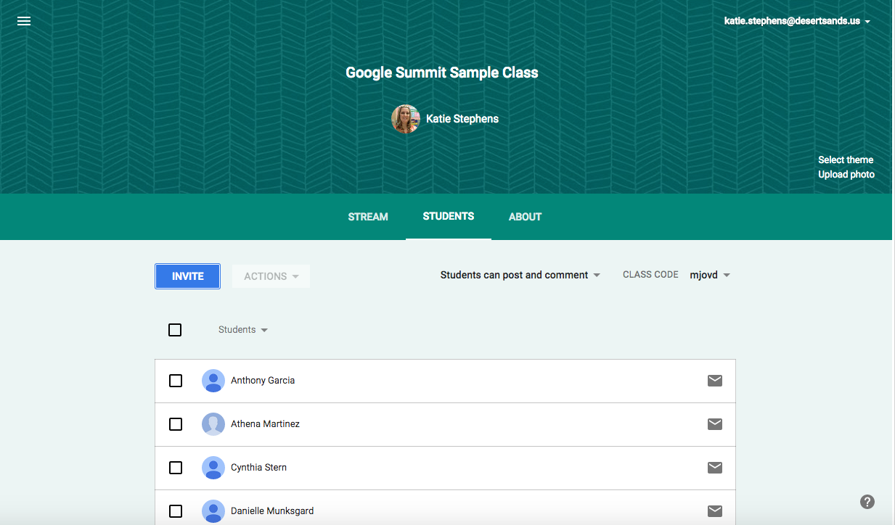
Parts of your Classroom
The students page is a list of all of the students enrolled in your classroom.
Can change the students abilities to post and comment in your classroom.

Slide 13
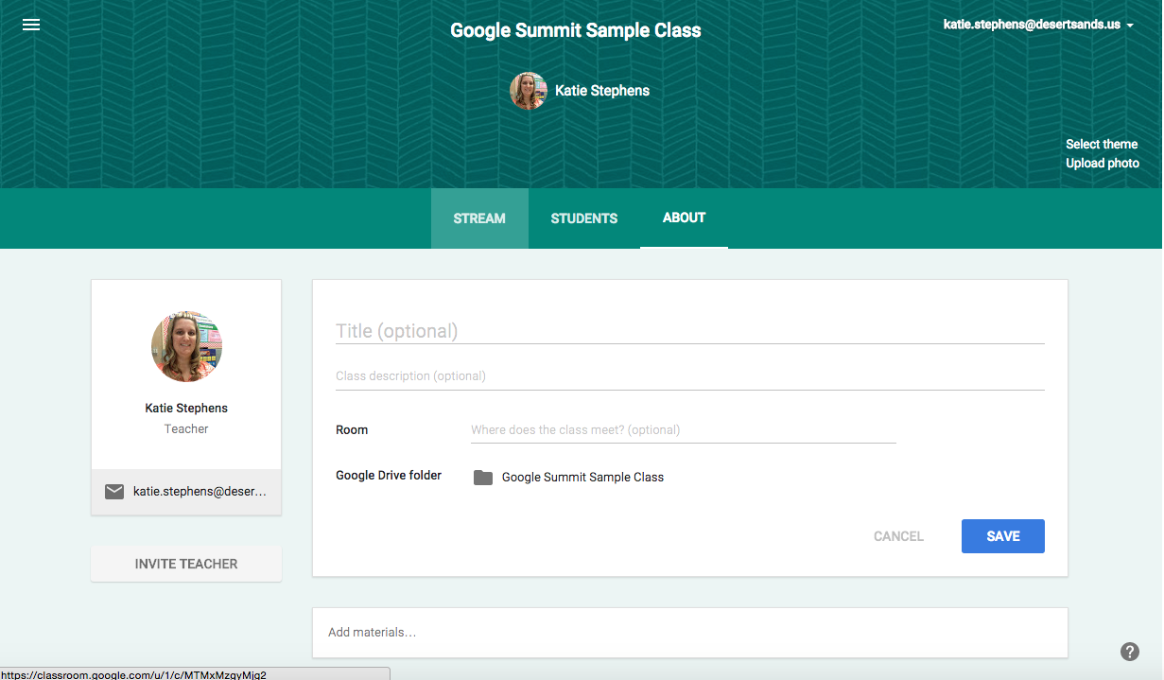
Parts of your Classroom
Change and edit the information about your classroom. Post links.
Invite more teachers to join your classroom. *If you add a teacher, they will be able to do everything that you can do, except delete the classroom.

Slide 14
Classroom Homepage
The stream is where you will post your announcements and assignments.
When you create a new announcement or assignment it can save as a draft. So if you don’t want to post it right away, you do not have to. It will save it for you to post later.

Slide 15
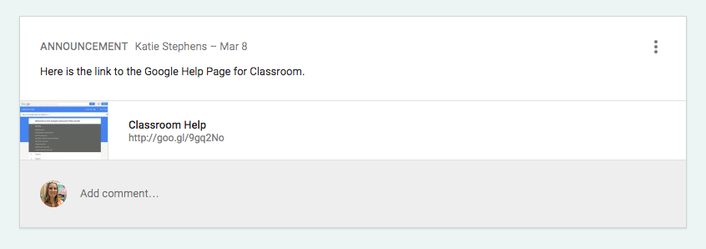
What is an announcement?
Google Classroom gives you a place to post your announcements.
Unlike a website with one way communication, students can comment back on the announcement.

Slide 16

Ways to use Announcements
A place to make announcements to your class
A place for students to make announcements to each other
(ie: kudos, questions, concerns, updates)
Ticket out the Door or Warm-up
Virtual Classroom Discussion
Quick Write Prompt
Share Links with your students

Slide 17
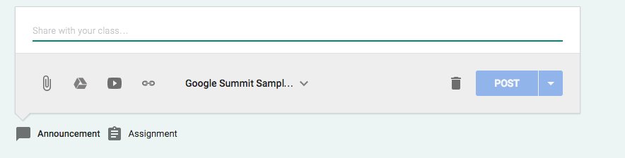
How to make an Announcement
Click on announcement.
Type in your announcement into the top box.
You can add attachments, files from your drive, youtube links, or links to other sites.
Then click on the class that you want to post the announcement. You can post the same announcement to multiple classes at one time.
Then click post.

Slide 18
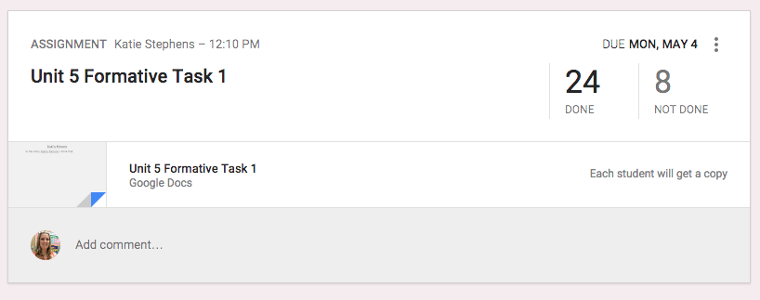
What is an assignment?
Using Google Docs you no longer need to collect and pass out paper.
Google Classroom eliminates sharing issues by placing the document in the teacher and the students Google Drive immediately.
Students simply need to press the “turn in” button within Google Classroom to let the teacher know they are ready to have their work assessed.

Slide 19
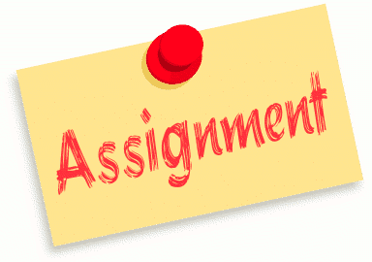
Ideas for using Assignments
Collaborative Group Assignments
Individual Writing Assignments
Note taking templates
Tests and Quizzes
Test Prep
Project Based Learning

Slide 20
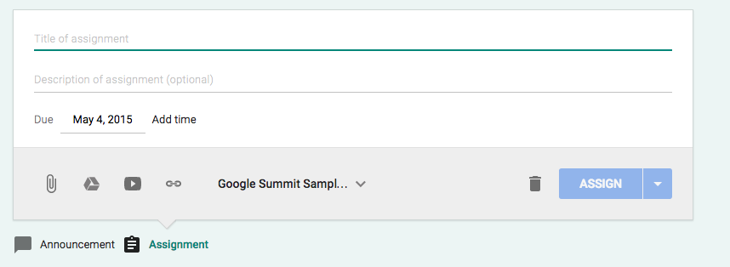
How to make an Announcement
Click on assignment.
Type in your title into the top box and add a description into the next box below.
You can add attachments. (See next slide).
Then select the due date.
Then choose the class that you want to post the assignment, you can post it to more than one classroom at the same time.
Then click assign.

Slide 21




Attachment Options for Assignments
Attach a document from your computer
Attach directly from your Google Drive
Attach a YouTube Video
Attach a Link

Slide 22
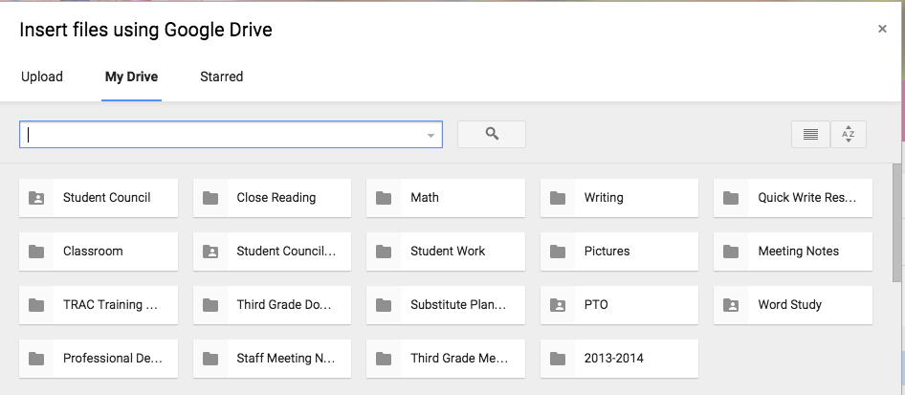
Attaching Directly from Drive
Click on the Drive icon
Search for your document in the window that pops up and click add

Slide 23
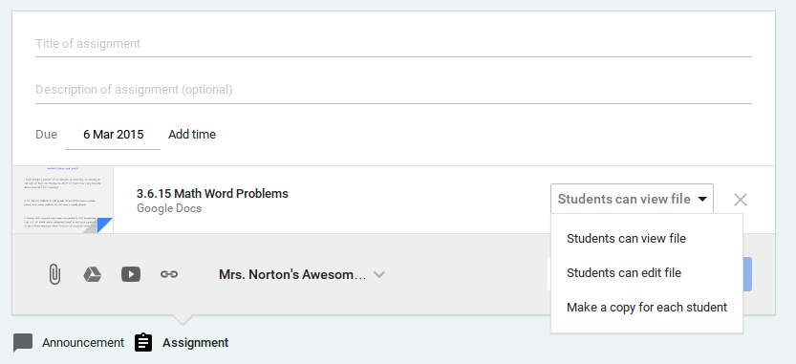
3 Choices when Attaching from drive
Students Can View File
Students Can Edit File
Make a copy for each student

Slide 24
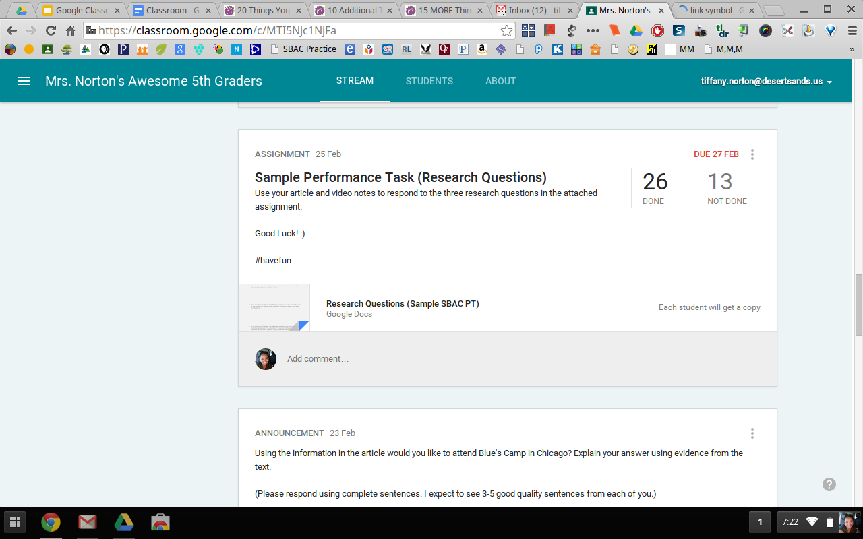
Tracking your students progress
Easily see the number of students who’ve completed and have yet to complete the given assignment.

Slide 25
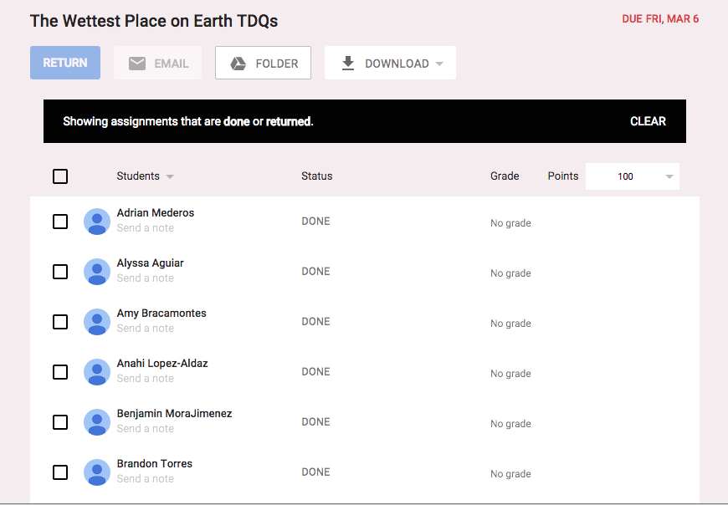
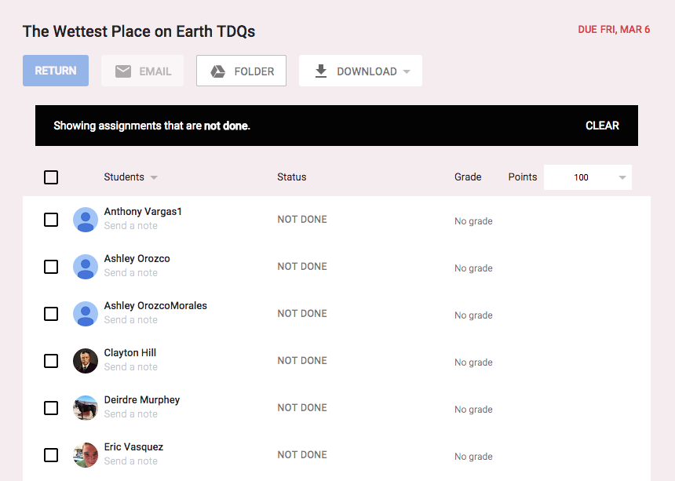
The detailed list of students who have not completed their work.
The detailed list of students who have completed their work.

Slide 26

Adding a Co-Teacher
-Multiple teachers can now serve as the
admin for each Google Classroom
-Who would I add as a Co-Teacher?
Intervention Specialists, Administration, Resource Teachers, Grade Level/Department Colleagues
Click the picture above to visit Alice Keeler’s blog post on this topic.

Slide 27
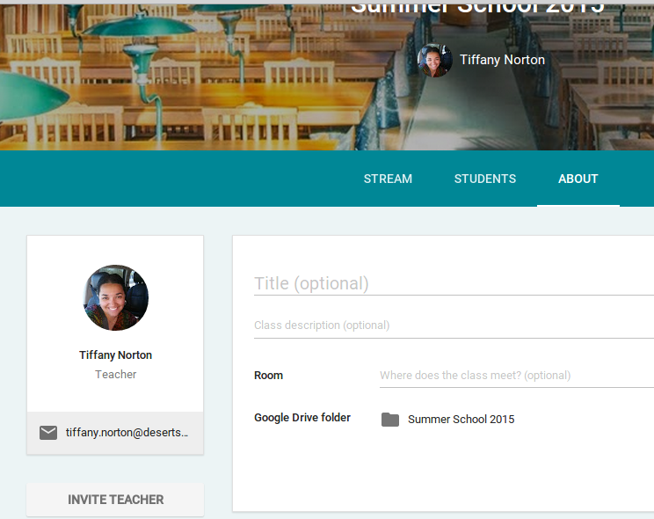
How to Add a Co-Teacher
Adding a Co-Teacher
-Open up the class you want
to use
-Click “About”
-Click “Invite Teacher”
-Type in the email address of the co-teacher

Slide 28
Archive a class
-End of Quarter/Semester/Year
-Archiving preserves materials, discussions, and posts. The archived class is taken off of your home screen.
-All files are still available in Google Drive to view and edit

Slide 29
Archiving a Class
-An archived class can be viewed by you and the students in the class.
-However, when the class is archived, you can't edit or add anything to the class until you restore it.

Slide 30
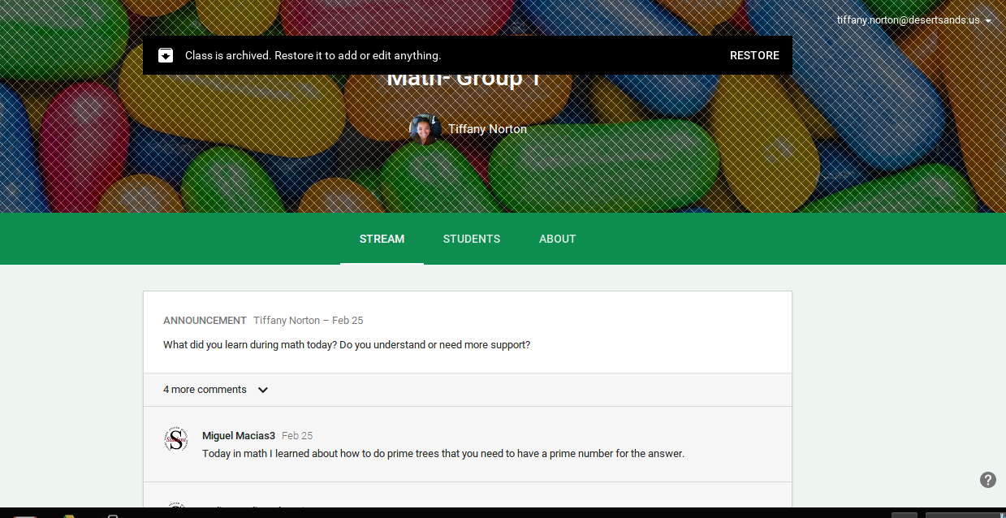
An Archived Classroom

Slide 31
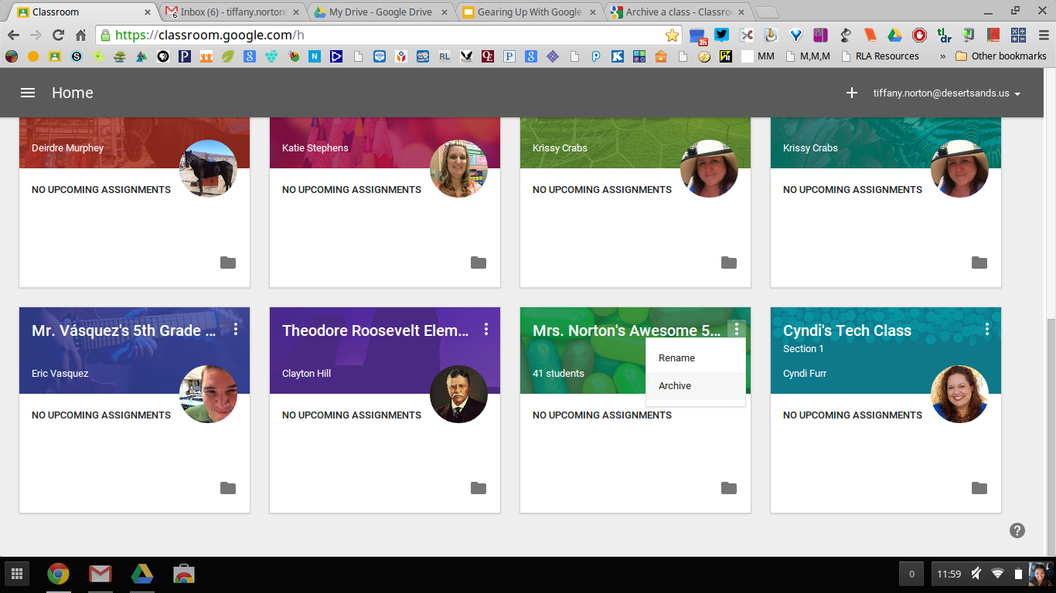
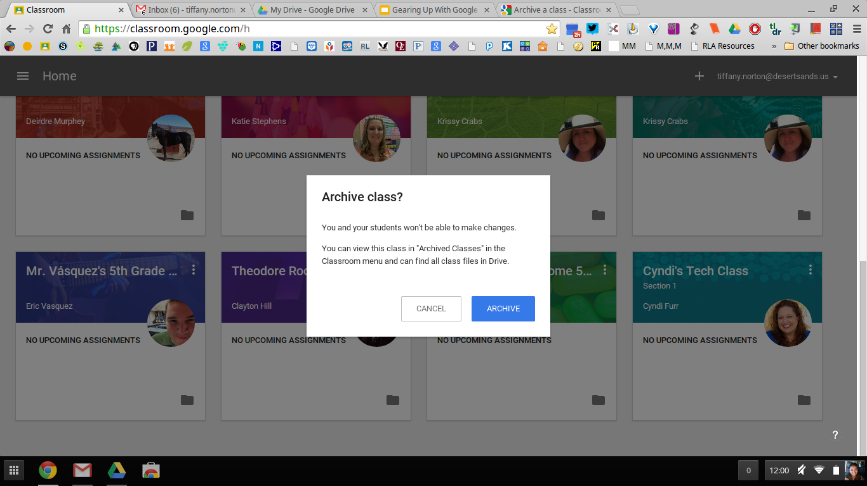
How to Archive a Class
-Click “Home”
-Click on the three dots next to the class name
-Click “Archive”
-When the ‘Archive Class?’ screen pops up, click “Archive”

Slide 32
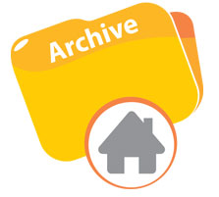
Need to view, restore, or delete an archived class?
Click here for directions from Google Support!

Slide 33
Drafting an Assignment or Announcement
-Pre-populate posts and have them saved in the “Drafts” section for posting at a later time
-Great for pre-set discussion questions, close reading questions, daily warm-ups, and much more

Slide 34
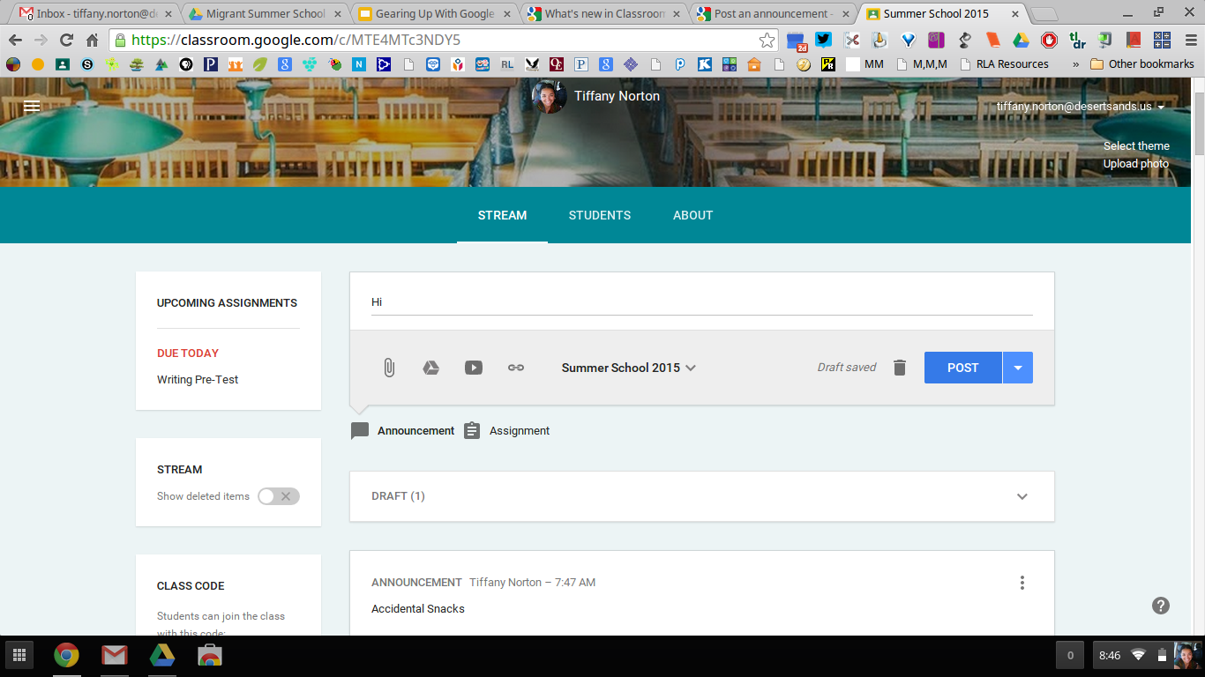
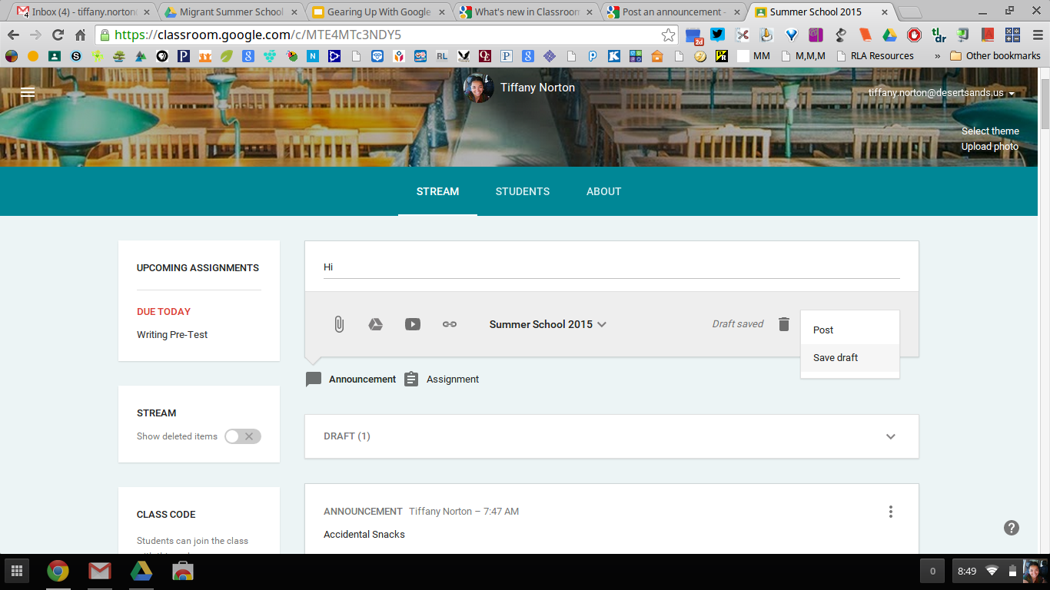
How to Draft an Assignment or Announcement
-Type in your announcement and/or create your assignment post
-Click the down arrow next
to the blue ‘POST’ button
-Click “Save Draft”

Slide 35

How to Draft an Assignment or Announcement, cont.
-The announcement/assignment is now saved in your drafts folder and can be posted when you are ready.

Slide 36
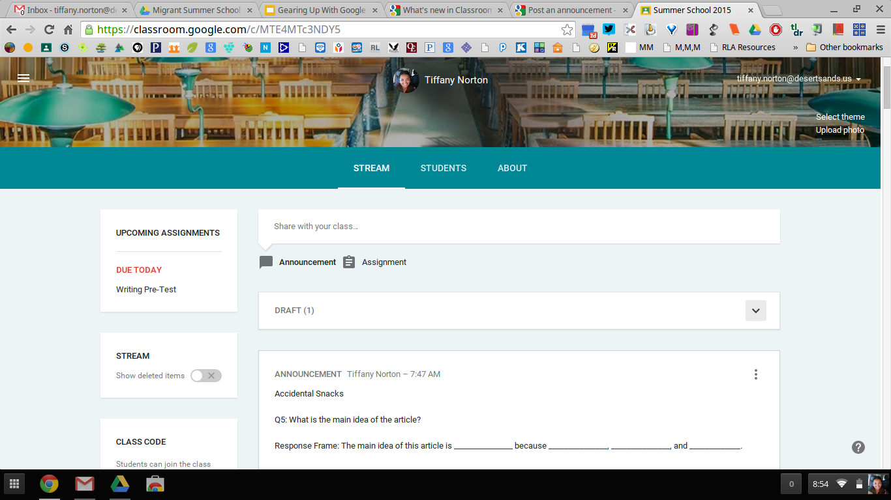
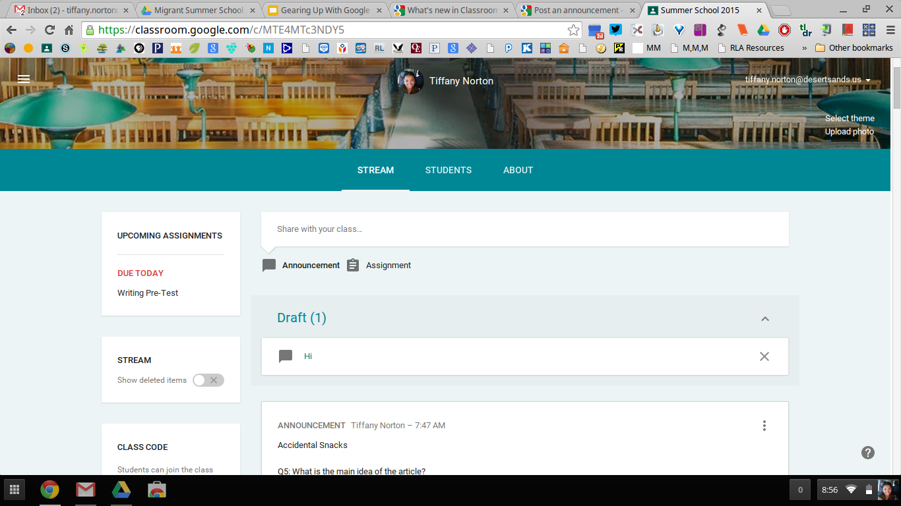
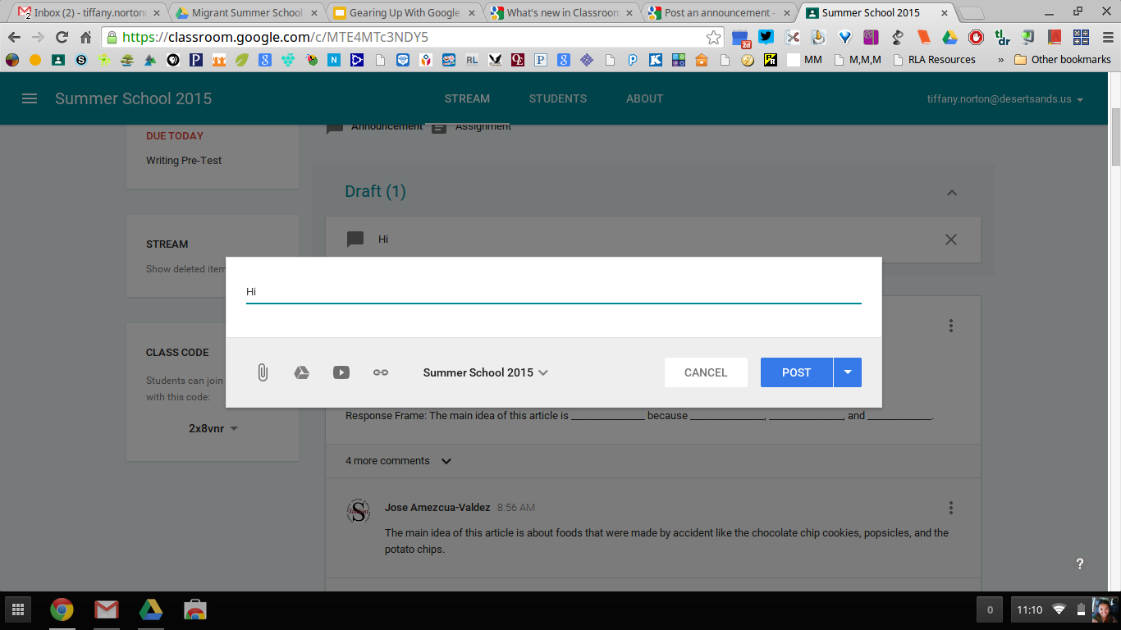
Click the down arrow to access your drafts.
Click on the draft you’d like to edit/post/delete
Edit the post (if needed) then click post or cancel. You can also re-save the Draft.

Slide 37
Mobile APP
-The mobile app allows students to do their work on any device.
-Perfect solution for classrooms that don’t have 1:1 access, but have a BYOD policy

Slide 38
Mobile App, cont.
Students can:
-attach photos to assignments and posts
-attach images, PDFs, and web pages from other apps to their assignments
-work offline on items listed on the to do lists

Slide 39
Links to more helpful hints and tricks
Google Classroom Help Center
Get the Mobile App (Google Play Store)
Get the Mobile App (iTunes)
50 Things You Can Do With Google Classroom (Alice Keeler)

